Slide 1





NRI 3.0: Innovations in Integration of Robotics
Integration of Autonomous UAS in Wildland Fire Management
Kickoff Meeting: Sensors and Systems Integration
October 29, 2021
Virtual Meeting

Slide 2

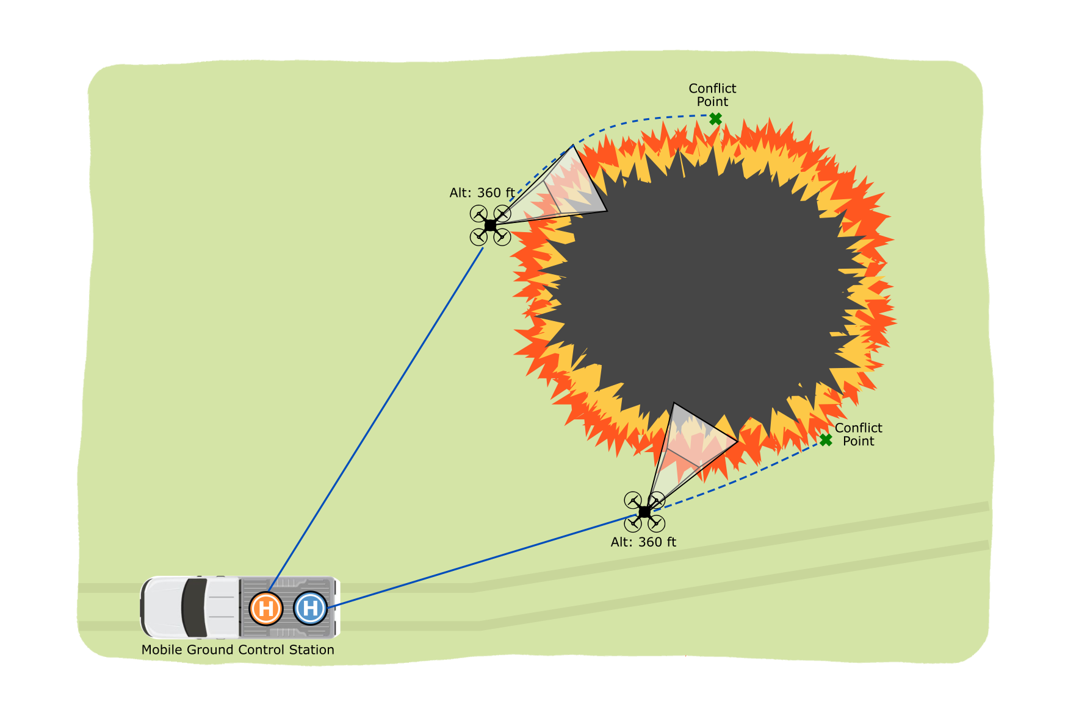


Flight Validation Setup
List of Agents:
Forecaster (Online)
Thermocouples (Offline)
TemSS (Online)
IR Cameras (Online)
RGB Cameras (Online)
UAV

Slide 3
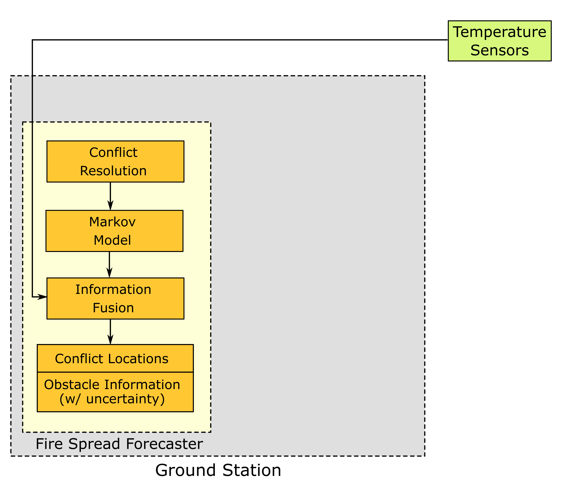
Sensor Systems

Slide 4
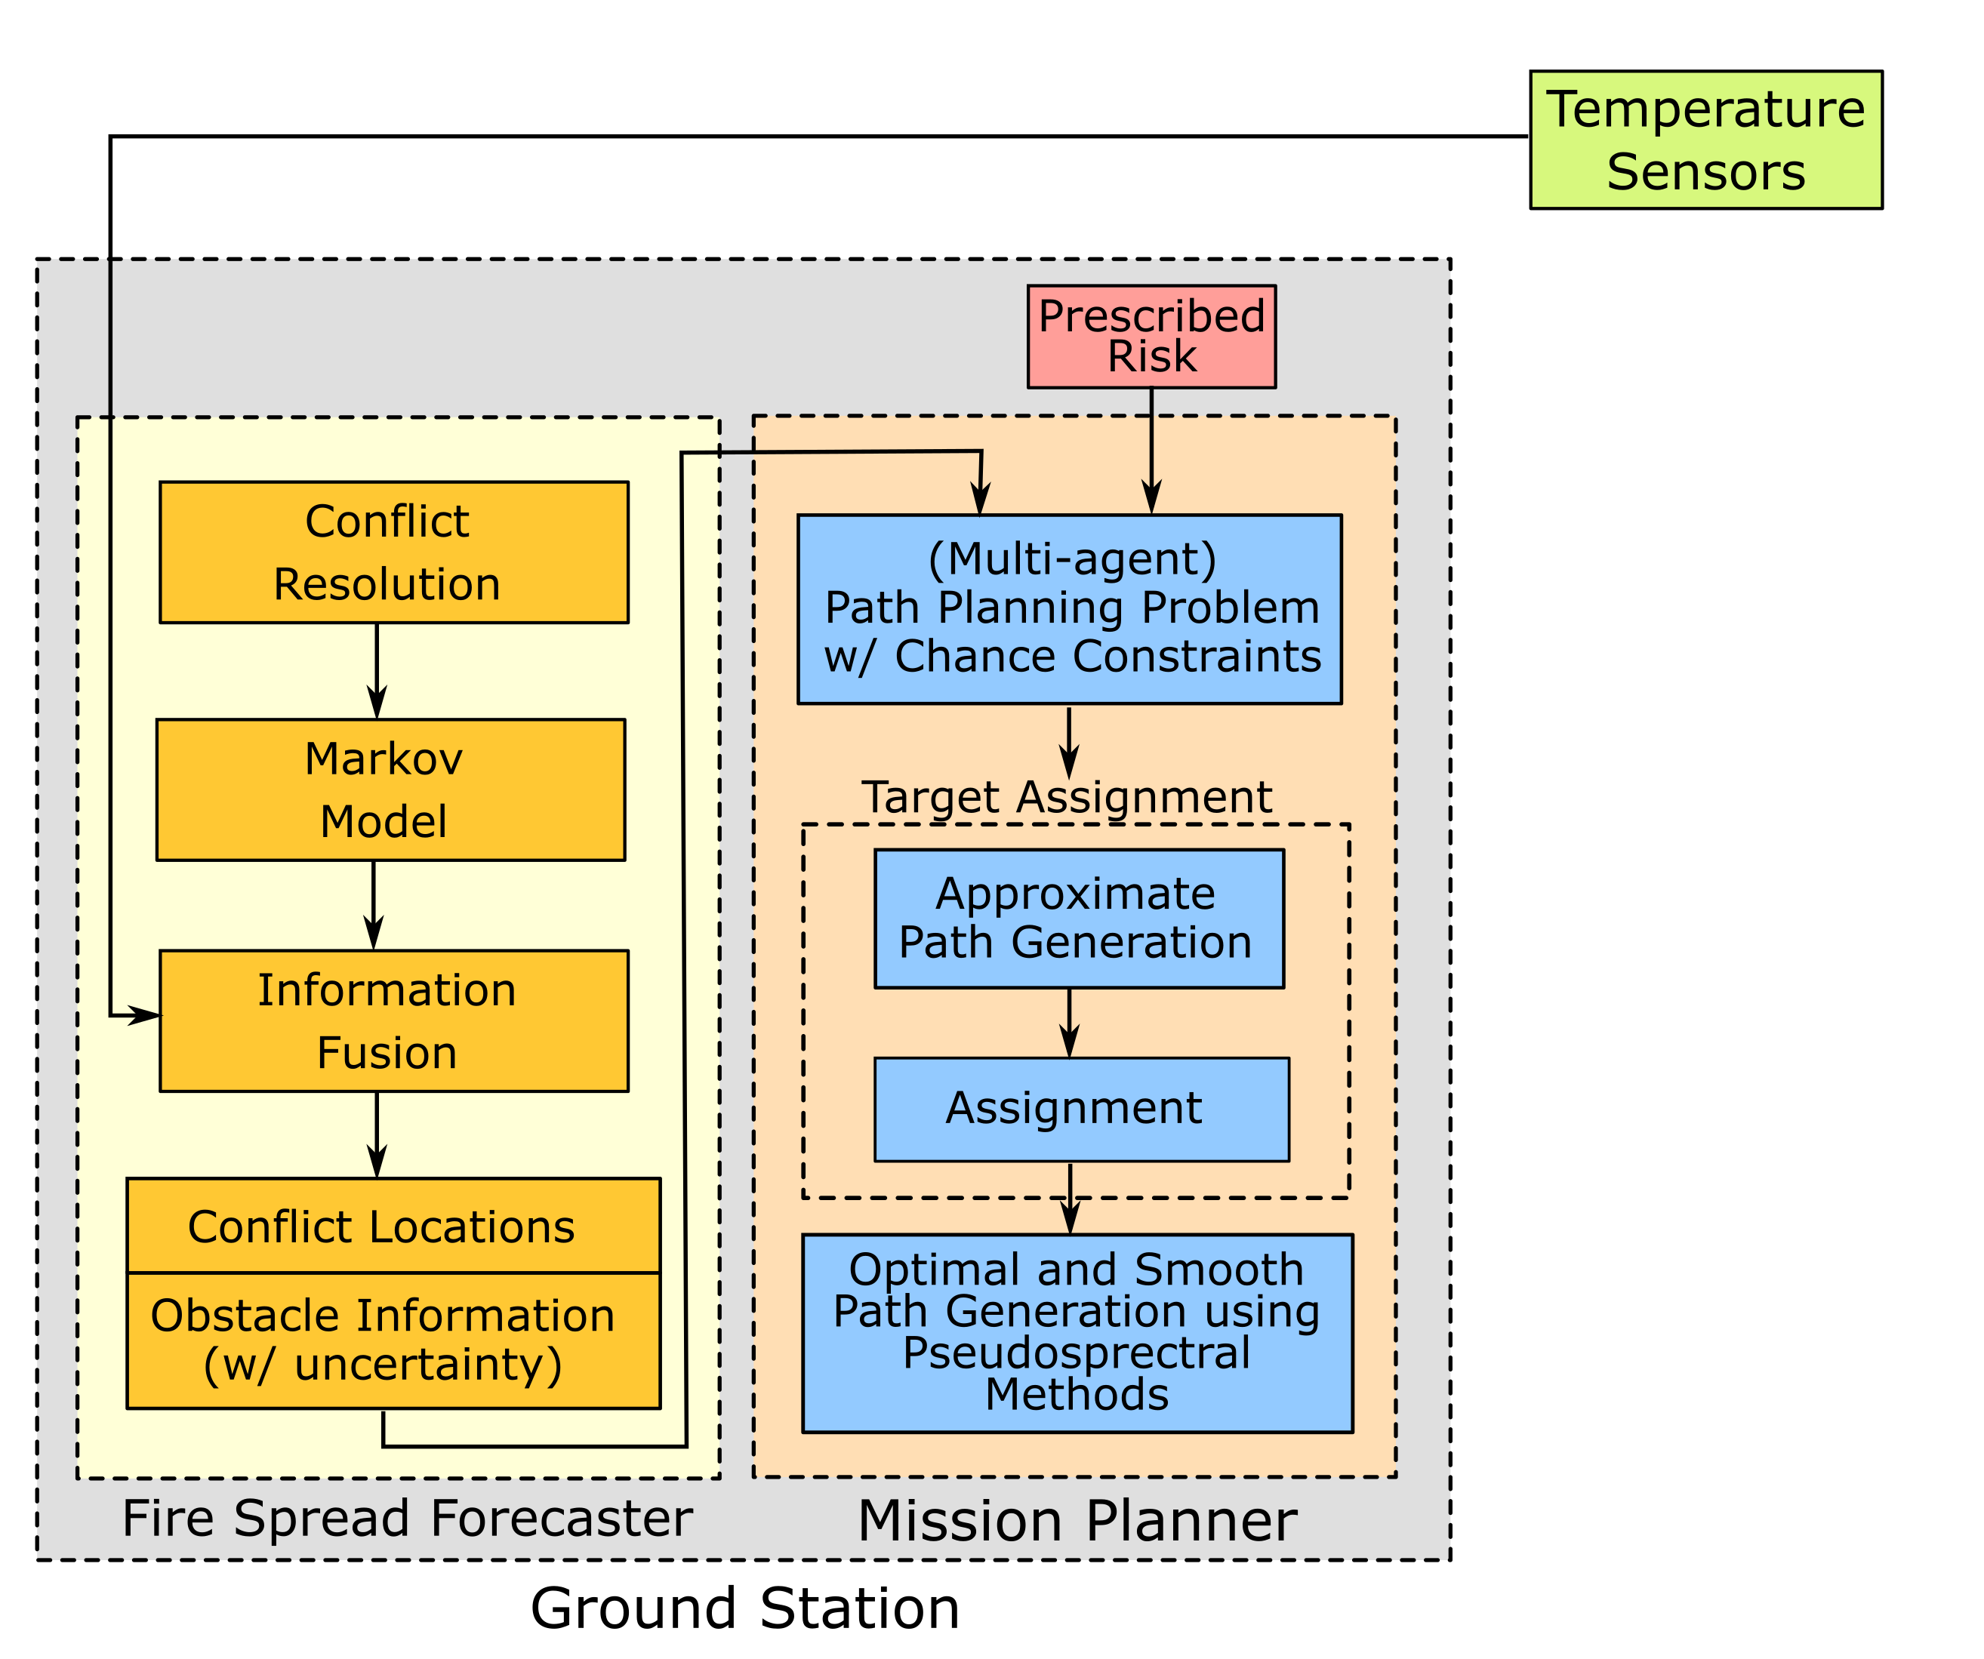
Sensor Systems

Slide 5
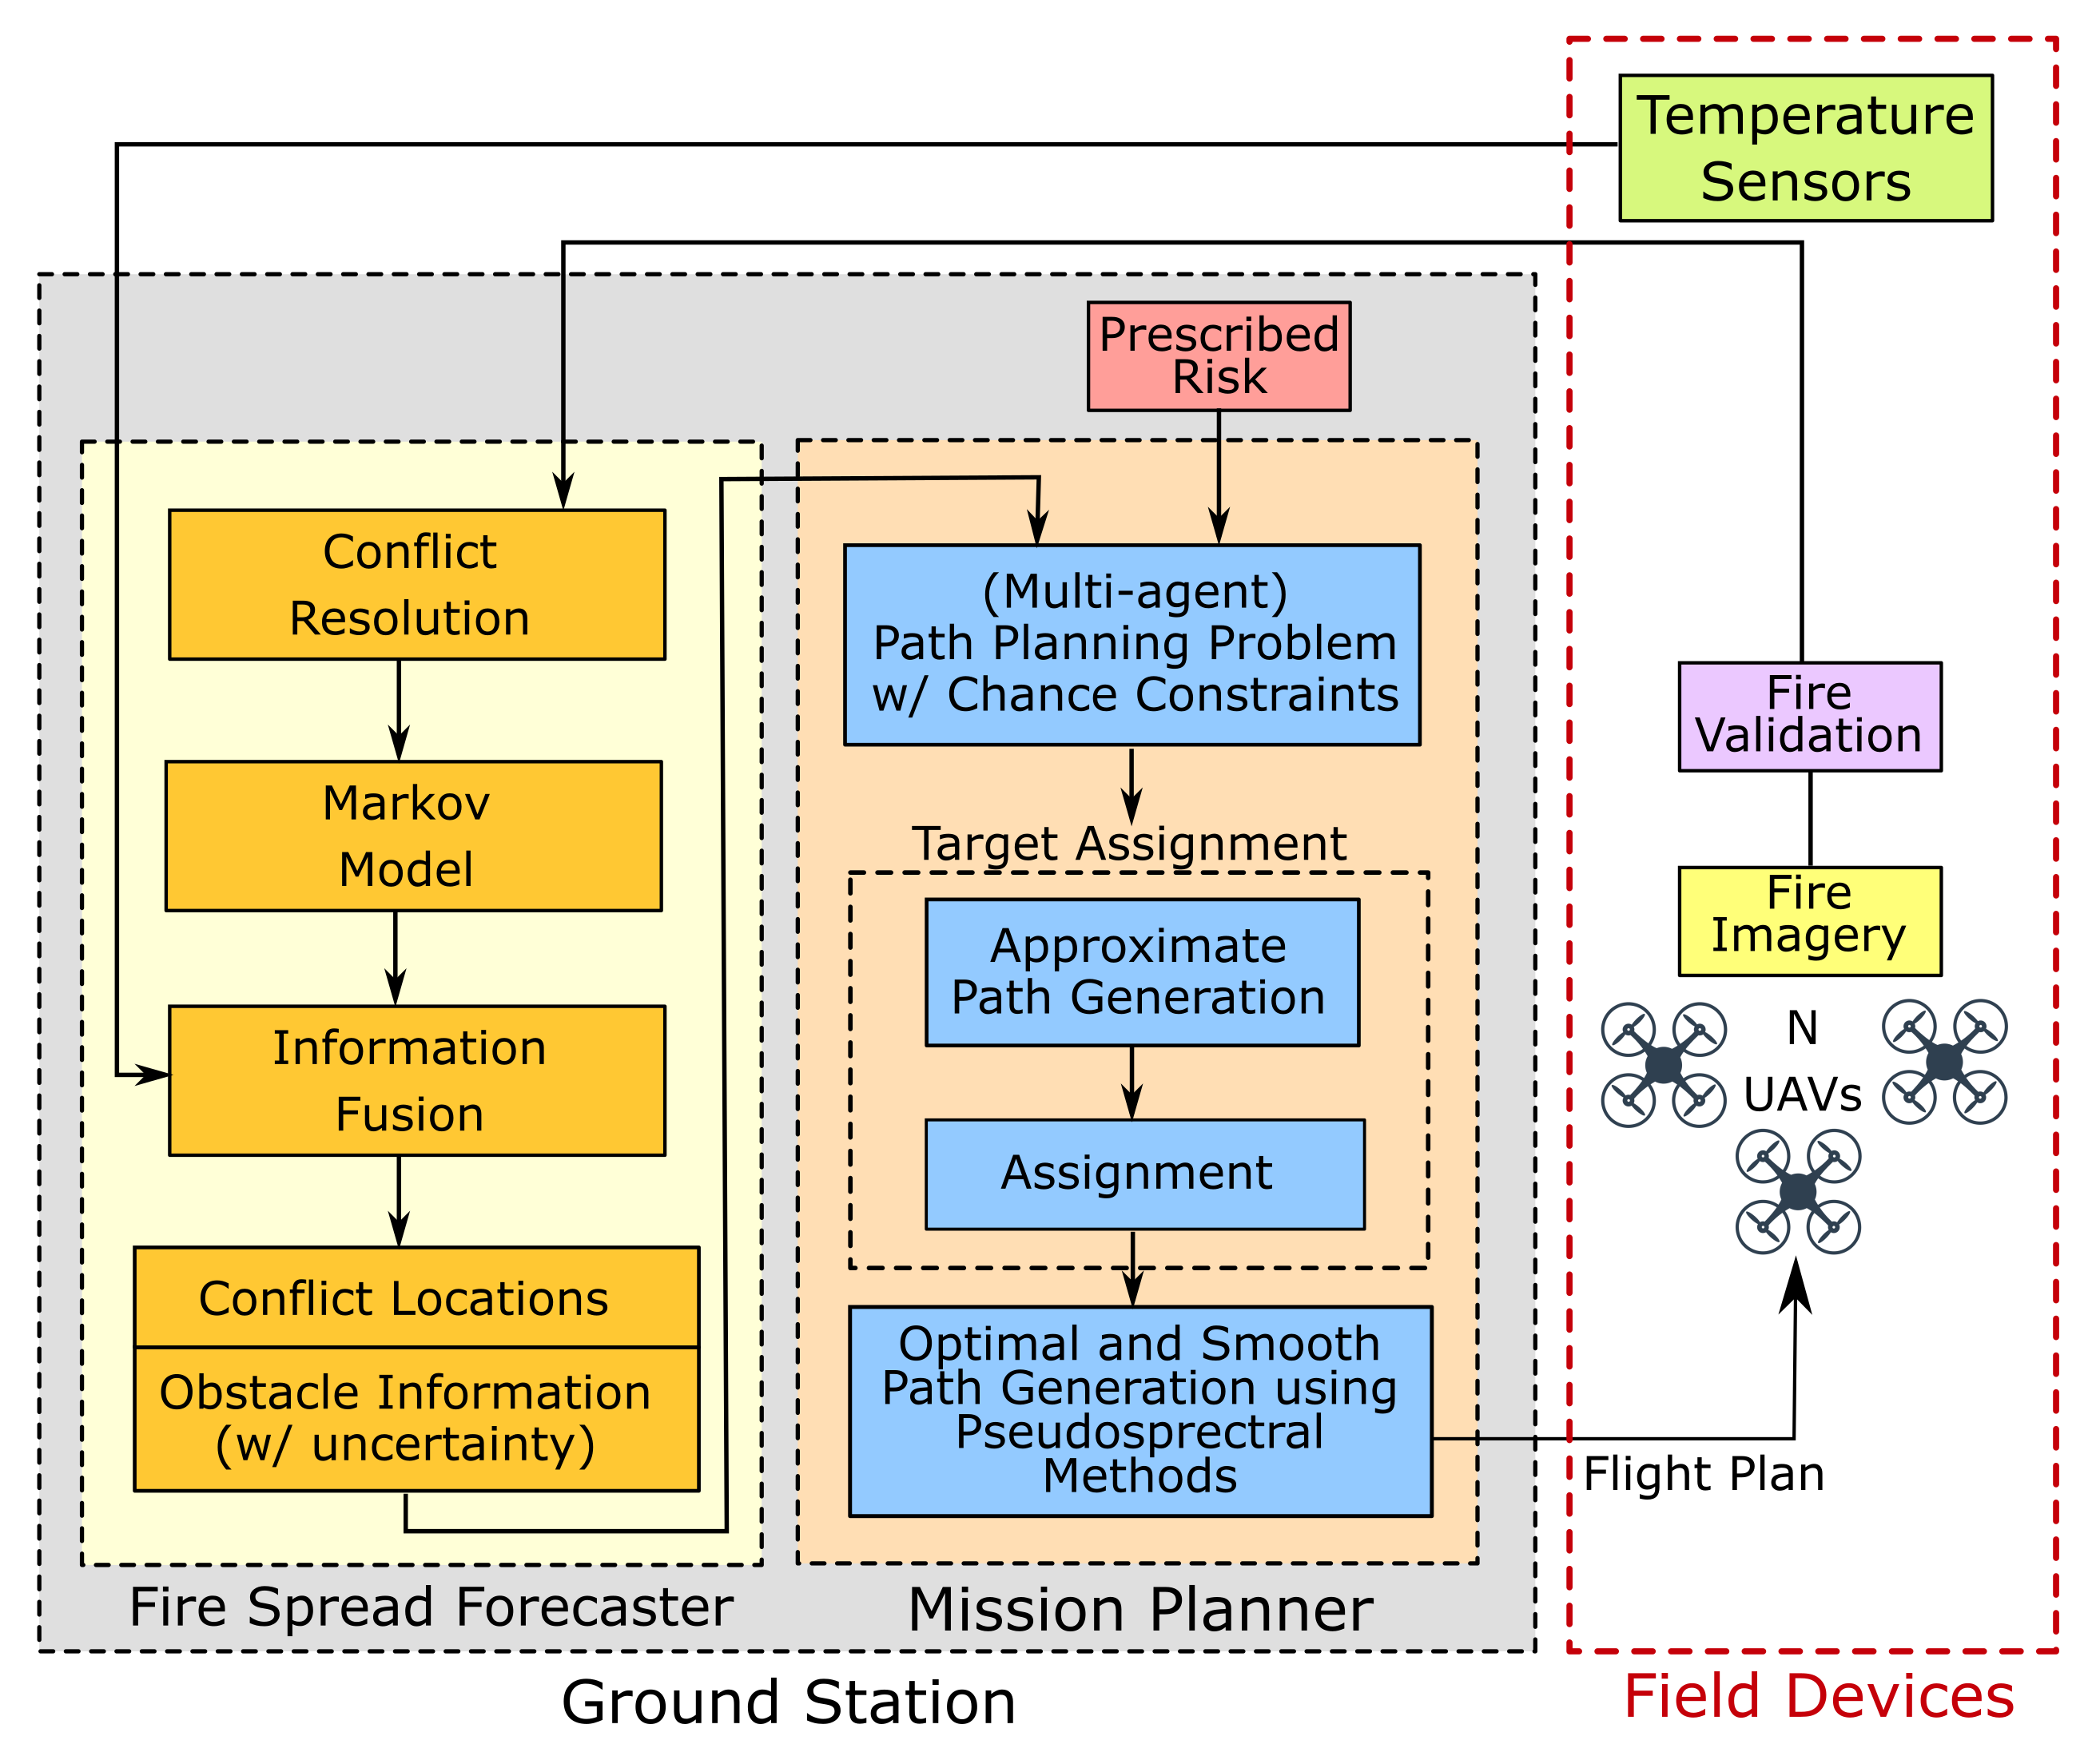
Sensor Systems
Systems to be Integrated
Forecaster
Mission Planner & Path Planner
TemSS
UAV Data (Imagery & Temp)

Slide 6
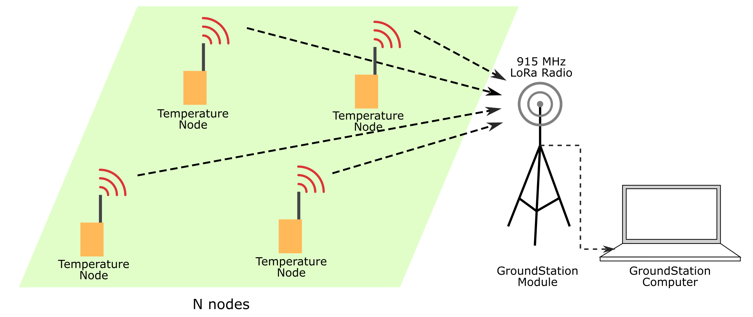
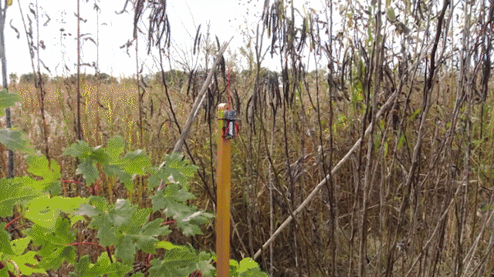
Sensor Systems: TemSS
Design Objectives
Challenges
Approach

Slide 7
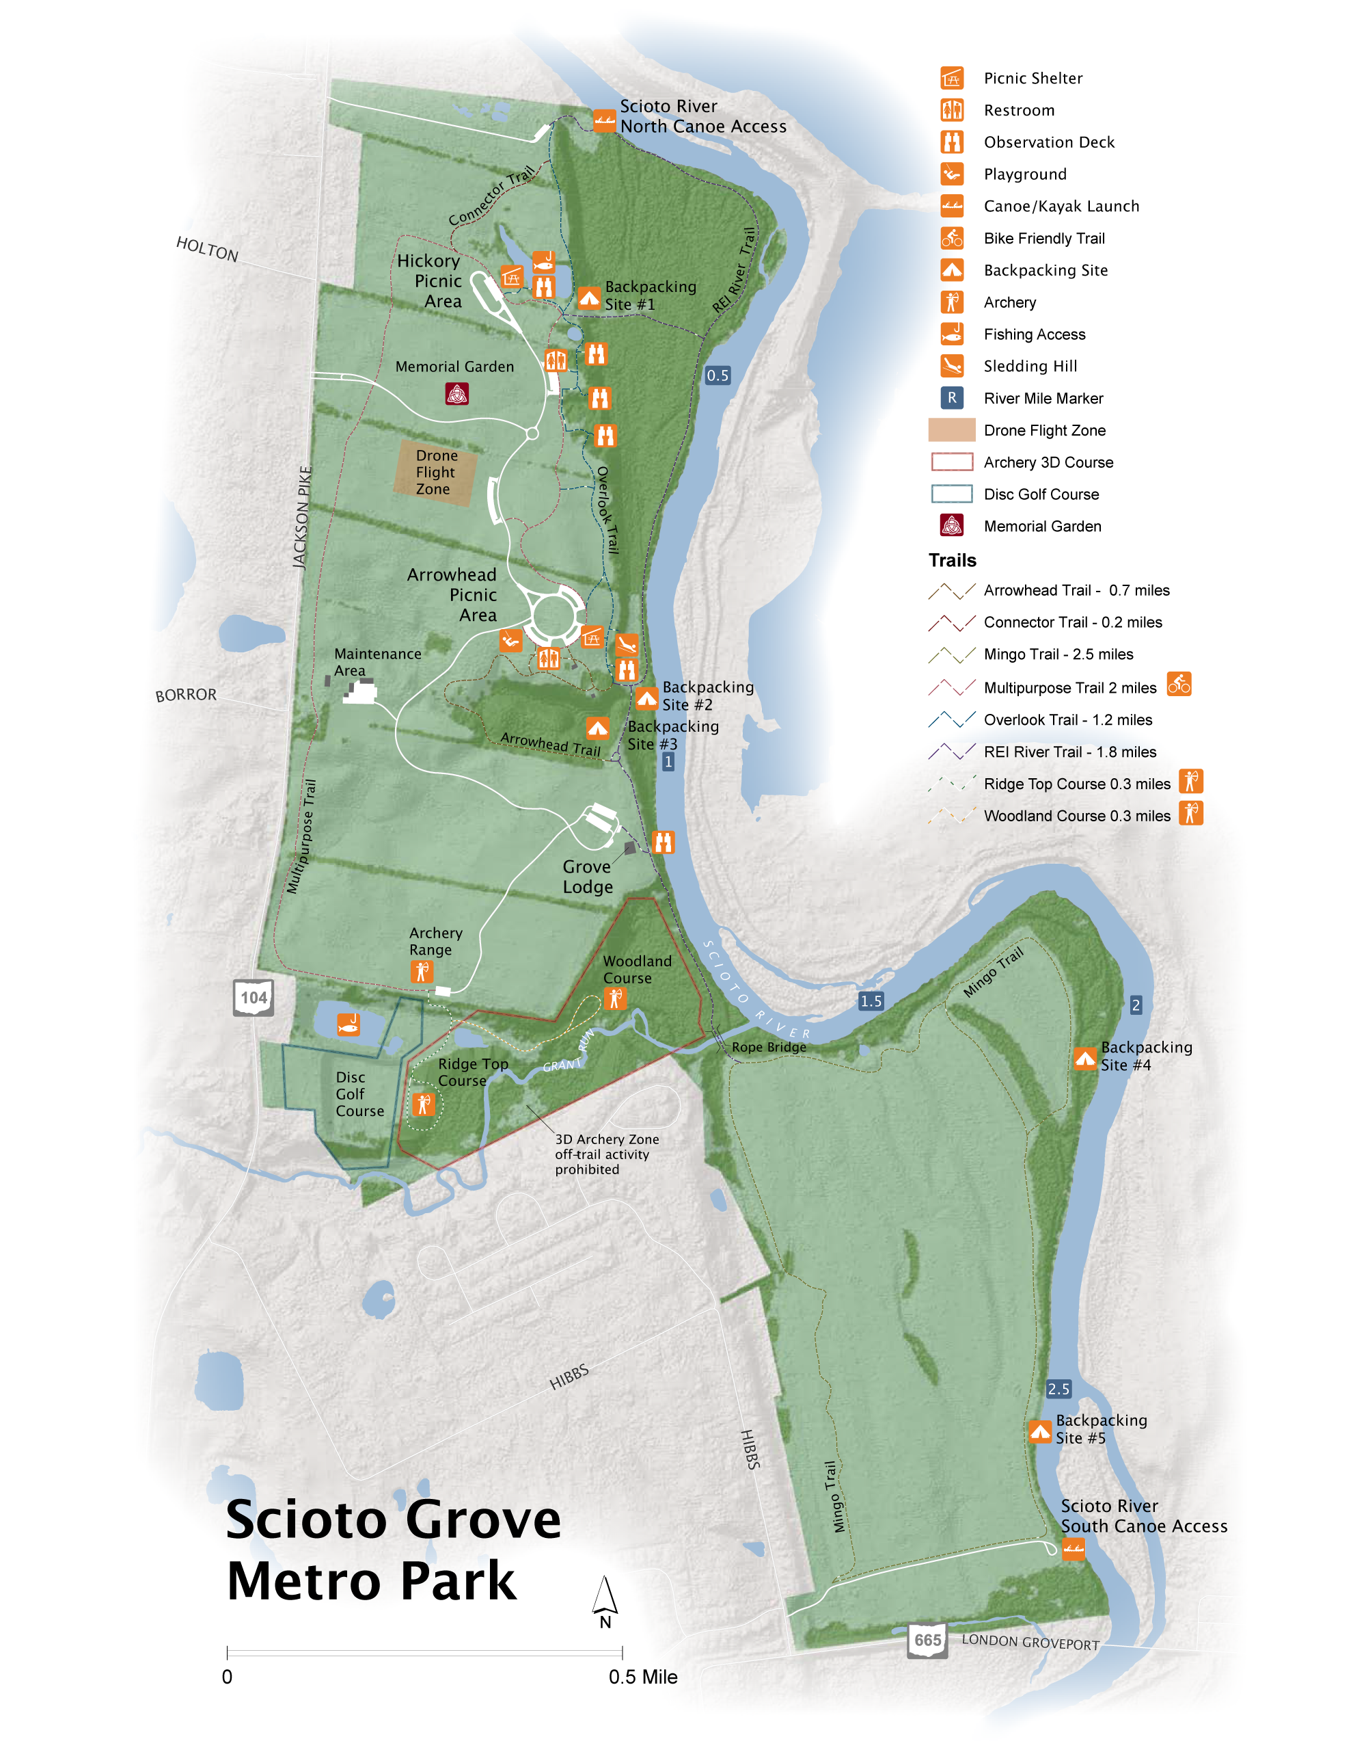
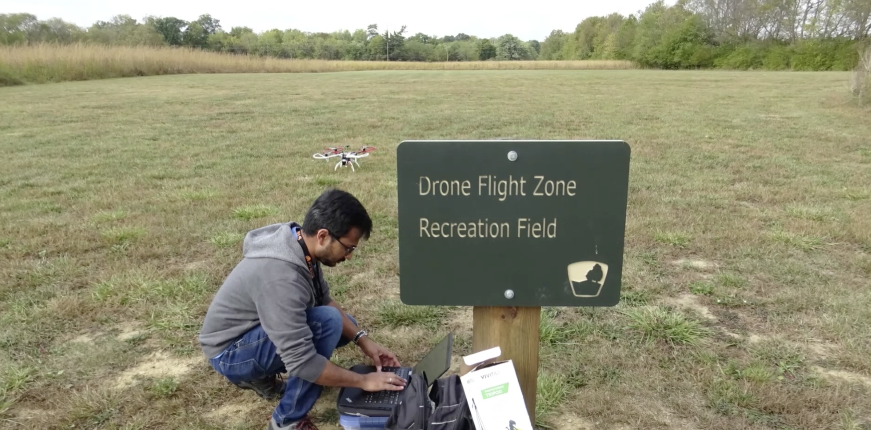
Flight Plan: Columbus Metroparks

Slide 8
User Interface: Virtual - Physical
Interface

